Slide 1

FAST (Document Integration)
Proposed
Automation Roadmap for Drug Development Lifecycle
Notes:
A note for instructors about the format of the instructor materials:
The following materials are for the use of the instructor in teaching the RMUC course. Each instructor needs to decide how to use the slides to best fit his or her teaching style.
Many slides are accompanied by instructor notes and/or by student notes. The instructor notes on a slide give suggestions to the instructor about how to present the information on the slide, particular points to emphasize, and background information. The student notes on a slide give more detail and additional information about the topic of the slide.
Instructors should be familiar with the student notes in addition to the instructor notes because the student notes contain detail that the instructor may need to mention. The instructor should NOT expect or encourage students to read the student notes during the class itself.
Suggestions for introductions are given on the following slide.

Slide 2

Business Overview
Proposed Automation Roadmap
Appendices (Technical Overview)
Agenda

Slide 3

Background
Automation Goals
Use Cases (scenarios / opportunities)
Business Overview

Slide 4
Background
About a year ago, we presented a phased approach for automating the drug development lifecycle in R&D. Since then, we have completed a thorough analysis of our current business processes and identified a number of opportunities to improve the process.
This deck will revisit the original premise for the initiative, align the opportunities for improvement and present a progressive roadmap for addressing the currently identified needs as well as those that we may uncover as we improve our competitive position and expand our capabilities for drug development.

Slide 5
Goals
Reduce effort & time for individual projects (cycle time)
Reduce risks (associated with change & variability)
Improve extendibility
Improve adaptability
Improve resiliency
Improve flexibility
Improve knowledge sharing (globally)
Improve collaboration w/in & w/out R&D

Slide 6
Use Cases
Reduce effort & time for individual projects (cycle time)
  Shift from manual to automated workflows will reduce handoffs and transitions between staff
  Decisions are accelerated by having information available in a more timely fashion
  Shift from a document-centric process to one that is data centric to reduce overall effort and costs for a project.
  Real time monitoring of processes, projects and programs will reduce the need for status reports and meetings for program managers and management.
  Workload balancing along with identification of latency in process flows will allow management to optimize cycle time.

Slide 7
Use Cases
Reduce risks (associated with change & variability)
  Changes to processes and/or SOPs can be made, reviewed and pushed out w/in hours or days.
  Anomalies in the process can be addressed in real-time rather than incurring extended wait times
  Implementing changes should not require extensive training since the process should drive the right behaviors and decisions (reflective of the changes)
  Knowledge is captured along the way, embedded in the process and made available to mitigate impact due to staff attrition and/or learning curves for process changes.
  Support electronic signature and enable security over processes and data throughout the lifecycle.

Slide 8
Use Cases
Improve Extendibility
  The same process framework and knowledge repository should be able to support product development within the current drug pipeline as well as future products (breadth).
  The process should be able to handle existing volume of projects in the generic drug development pipeline and scale to handle more project volume in the future (scale).
  New features can be easily added to the automation platform w/ little effort and w/o impacting existing projects already in progress (breadth).

Slide 9
Use Cases
Improve Adaptability
  Processes adapt to changing business conditions and/or unplanned events w/o IT intervention
  Business rules can be maintained and updated to address new conditions and/or improve decision support as part of continuous improvement w/o IT intervention
  The process flows can be easily adapted from handling generic drug development to address biogenerics and more complex pharma engineering development.
  The system can capture & share new types of knowledge as the drug development process evolves and expands w/o expensive changes to the platform and repository.

Slide 10
Use Cases
Improve Resiliency
  As anomalies arise, the processes will not simply fail if an unplanned condition is encountered.
  If errors occur, the system will attempt to self-heal itself for simple errors and route more complex errors to knowledge engineers and/or support rather.
  The system should be fully auditable with end-to-end traceability where issues and/or deliverables can be reproduced at any point w/in the process flow.
  A fail forward process should be built into the platform to ensure the system continuously “learns” and improves.

Slide 11
Use Cases
Improve Flexibility
  New functionality should require decreasing amounts of effort over time as the platform matures (suggests reuse is a core competency).
  Existing component processes should be able to be leveraged for secondary and tertiary processes which are used as inputs to (or outputs from) the core drug development processes.
  Process behavior (directional flow) should be easily modified w/o significant effort (initially light IT involvement, eventually no IT involvement).

Slide 12
Use Cases
Improve knowledge sharing (globally)
  Data and knowledge is captured at every point in the lifecycle for projects
  Knowledge is made available for resources to consume through publish or subscription services
  Ability to find knowledge thru explicit & implicit search
  Knowledge is shared according to the 5 Rights:
    Right Information
    Right Format
    Right Timing
    Right made
    Right amount

Slide 13
Use Cases
Improve collaboration w/in & w/out R&D
  Information from forums, wikis, blogs, discussions and other social networking tools will be captured and aligned with process deliverables, projects and programs.
  Individuals (w/in & w/o R&D) will be able to collaborate on projects, programs across the entire development lifecycle
  Individuals will be able to search across all types of collaborative content and find related knowledge associated with projects and deliverables.
  Teams will be able to share lessons learned for projects to promote continuous learning

Slide 14
Proposed Automation Roadmap

Slide 15
Opportunities for Automation
Business Process Automation (BPMS)
  Automated workflow & services
  On Demand monitoring, load leveling & governance
Business Rules Automation (BRMS)
  Automated decision making
  Automated intelligence
Configuration Management (ECM)
  Dynamic modeling (products, batch records, BoMs)
Knowledge Management (KM)
  Collaboration (project, team, program, R&D)
  Document Management
  Learning & Knowledge Sharing

Slide 16
Opportunities for Automation
Individually, each of these automation investments would provide enterprise value to Hospira.
Collectively, they will provide R&D with an agile, adaptable and scalable platform to achieve the current set of goals (prior section) as well as future goals as the business reaches 10-in-10 and beyond.
The following slides provide a phased approach for implementing the automation investments along with a roadmap of capabilities that address the desired outcomes along the way.
A more detailed overview of the architecture can be found in Appendix A along with an overview for each of the automation tools.

Slide 17
FAST Automation Roadmap
Efficiency
Collaboration
Model-Driven BoM creation for MFG
Enable Open Collaboration outside of Hospira
Reduce risks (associated with change & variability)
Capture knowledge from R&D, MFG & Quality to embed into the models used to accelerate product development & commercialization
Improve resiliency by enabling self-healing processes & automated error handling
Changes to plant equipment & environment are modeled and dynamically reflected in Batch Records
Integrated Knowledge & Content Management
Adaptability
Model driven development of engineering methods & MTS
Migration off of documents
Proactively push knowledge to decision makers
Real-Time Monitoring of processes & programs
Start Defining & managing
(Metadata) centrally to better align knowledge
Minor changes to ingredients or recipes takes days instead of weeks
Reduced staff effort
Improve collaboration w/in & w/out R&D
Capture knowledge throughout the development lifecycle
Leverage meta data & rules engine to abstract change from processes
Automated generation of MFG BoM
Build reusable document components to expedite new feature development
Speed
Evaluate Knowledge Mgmt Solution
+
Integration w/ BPMS to warehouse documents
Automated generation of CTD for all drugs
Extend process automation to cover upstream and downstream processes
Parallel workflows and accelerated deliverables
Automated generation of Process Plan
Evaluate Business Process Automation Solution
Build remaining interfaces to existing systems (including SAP)
Pilot
Phase 1
Phase 2
Phase 3

Slide 18
Phased Approach
Pilot
  Select a Vendor to partner with for the business process automation layer (BPMS) (see Appendix B)
  Agree upon a representative scope & success criteria to evaluate the pilot
  Engage the vendor & their staff to build the scoped out solution with input from selected team members (no IT development staff involved in the pilot)
  Recommend we ask the vendor to build the pilot solution on their own environment and provide access to the HSP staff participating in the pilot (min. costs & setup time)
  Decision makers to evaluate results (go/no go decision)

Slide 19
Phased Approach
Phase 1
  Migrate from a document-centric to a data centric solution
  Define a data model
  Streamline the processes (simplify & run in parallel)
  Implement a BPMS solution for Generic Drug Dev.
  Implement a dashboard for real-time monitoring
  Automate flow of deliverables into CTD Publishing Tool
  Automate MTS creation
  Implement an ECM solution to capture documents & support knowledge mgmt (see Appendix D)
  Enable Collaboration and align content with projects
  Implement integration points (see Appendix F)

Slide 20
Phased Approach
Phase 2
  Enhance process automation with intelligence
  Implement a rules engine (BRMS) (see Appendix C)
  Centralize rules management
  Implement self-healing & resiliency in the system
  Implement meta data management to align data & content
  Build proactive services to improve knowledge (5 Rights)
  Continue automating integration points (see Appendix F)
  Expand process automation to all drugs in all plants
  Automate partial feed of data into EBS build

Slide 21
Phased Approach
Phase 3
  Migrate from data-centric to model-driven
  Implement a configuration tool (see Appendix E)
  Model products, processes, plant, and equipment
  Implement an on demand solution that reduces cycle time for commercialization of product changes and new products introductions by an order of magnitude
  Automate the creation of the following artifacts:
    Engineering Bill of Materials (eBoM)
    Manufacturing Bill of Materials (mBoM)
    Process Plan (Batch Record)

Slide 22
Architectural Views
Appendix A

Slide 23
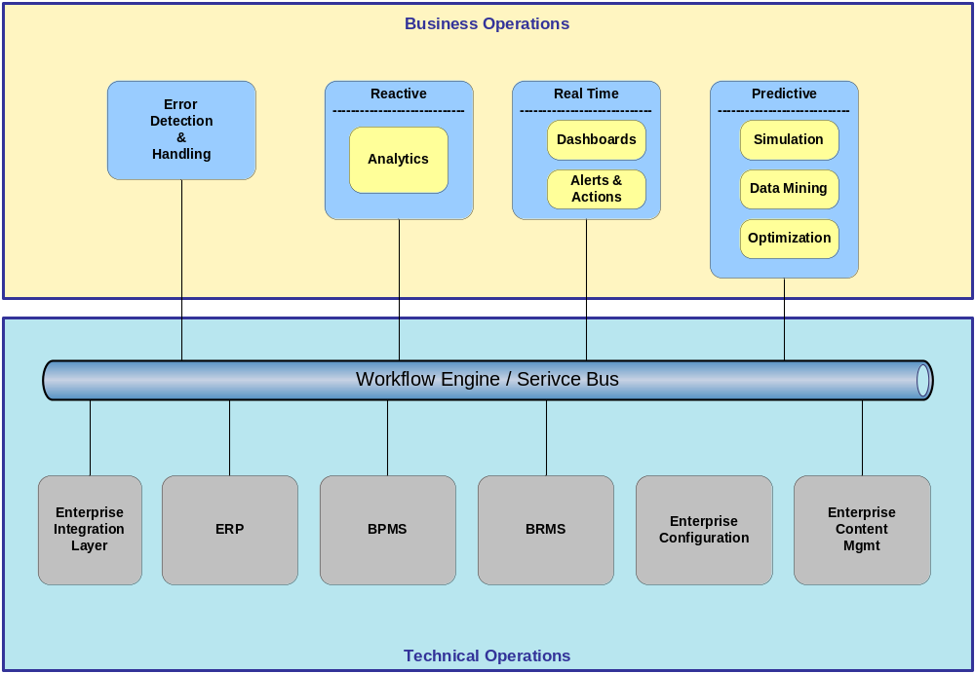
Architecture (Operational View)

Slide 24
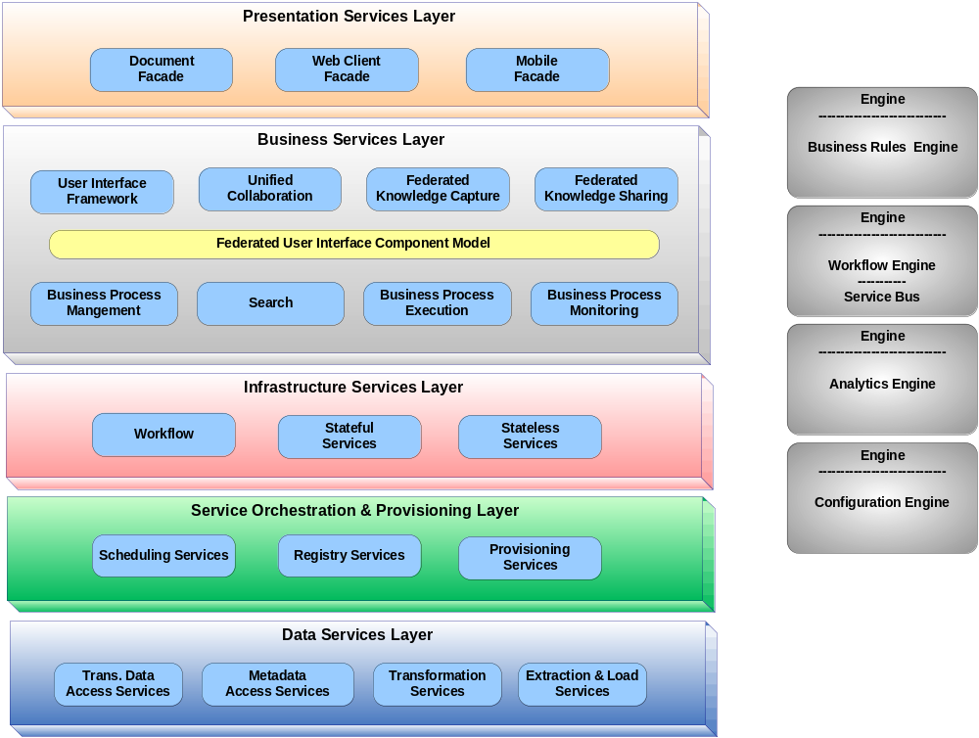
Architecture (Layer View)

Slide 25
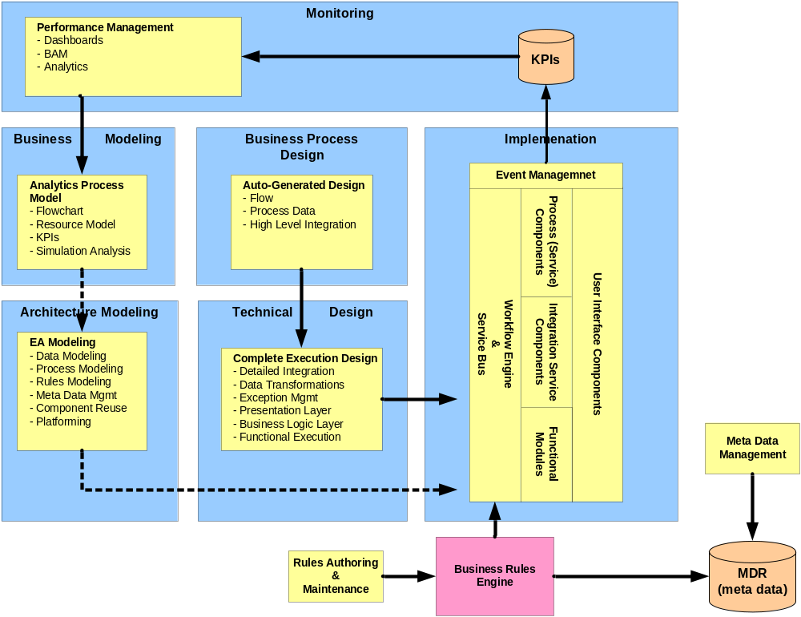
Architecture (Change Mgmt)

Slide 26
BPMS Overview
(Business Process Mgmt System)
Appendix B

Slide 27
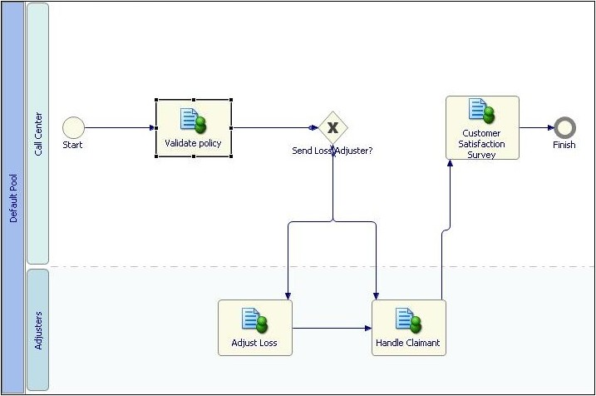
What’s in a BPMS?
Process modeler
Repository
Execution engine
System integration (web services)
Work-in-progress management
Monitoring and analysis
Simulation and optimization

Slide 28
BPMS Goals
Efficiency
  Automating steps and handoffs
  Integrating systems and data sources
Compliance
  Achieving and proving standardization
Agility
  Changing processes quickly and easily
Visibility
  See what’s happening in a process

Slide 29
BPMS Vendor Assessment
Solution | Key Features | Pros | Cons
E-Rooms | Identity Management Workflow (simple) Validated doc storage Forms generation (simple) | Already own the solution Have trained staff Already using the solution for MTS End users are already trained Standard tool for the plants Agile development | Does not meet all of the requirements (beyond the capabilities of the existing solution – would require extensive modifications) Maintenance costs to support the solution could be very high
Adobe Lifecycle | Identity Management Workflow (complex) Validated system Forms generation (complex) Integration with LDAP Integration with SAP Supports disconnected workflow Platform independent Compliant with FDA submission requirements | Widely adopted by Abbott Already being used for EBR generation Built-in validation & security Agile solution delivery Satisfies all desired outcomes Satisfied all key features Technical staff easily trained Support costs are minimal Supports high degree of reuse The solution could be deployed for device & drug (and many other areas) | We have to buy the solution Don’t have trained staff Requires initial investment Requires dedicated staff for support
SAP | Identity Management Workflow (complex) Validated system Forms generation (complex) | Already own the solution Have trained staff Key integration platform for PLM Can meet most of the requirements | Not an agile solution delivery Very high costs to build High costs for maintenance Does not meet all the requirements

Slide 30
Solutions being considered
Solution | Key Features | Pros | Cons
SharePoint | Identity Management Workflow (simple) Validated doc storage Forms generation (simple) | Already own the solution Have trained staff Already using the solution for MTS End users are already trained Standard tool for the plants | Does not meet all of the requirements (beyond the capabilities of the existing solution – would require extensive modifications) Maintenance costs to support the solution could be very high
MatrixOne | Identity Management Workflow (complex) Validated system Forms generation (complex) | Already own the solution Have trained staff Key integration platform for PLM Can meet most of the requirements | Not an agile solution delivery Very high costs to build High costs for maintenance Does not meet all the requirements

Slide 31
BRMS Overview
(Business Rules Mgmt System)
Appendix C

Slide 32
BRM Defined
Discipline for discovery and management of business rules
Methodologies and tools used to manage rules
What are business rules ?
  Business policies that define an action
    Decision
    Constraint
  Implicit in systems and procedures
  Explicit in BRMS

Slide 33
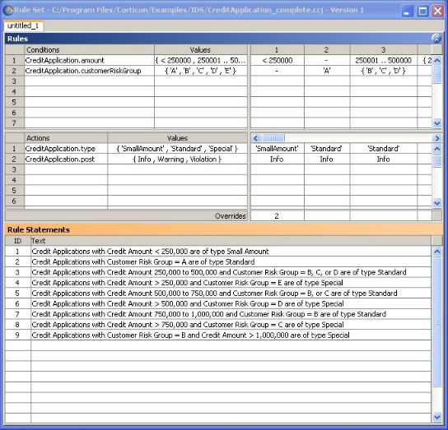
What’s in a BRMS?
Rules modeler
Rules repository
Execution engine
Monitoring and analysis
Simulation

Slide 34
Doesn’t a BPMS Have Rules?
Typically not full-featured BR:
  Simple Boolean rules for routing decisions
  Rules defined for a specific process step
Rule changes may require redeploying processes with IT involvement
Rule changes may not affect in-flight processes
Many process models don’t automate decisions

Slide 35
Separating rules from process
Externalize decisions from process
  Routing decisions
  Work assignment
  Set parameters
Call BRMS from BPMS for decision
  Standard web services call
  Tight integration by vendors

Slide 36
Splitting rules between platforms
In process model:
  Simple routing decisions
  Rarely changing
In rules system:
  “Business decisions”
  Frequently changing
Process and rules may be from same vendor

Slide 37
Benefits of a BRMS
BRMS can handle complex rules
  Ability to handle advanced rule design, harvesting, simulation
  Ability to reuse rules across processes/applications
  Ability to change rules without changing process
    Rule changes affect in-flight processes
    Business can change rule parameters
Benefits of combining a BRMS with a BPMS:
  Externalizing and automating decisions is the key to process agility
  More sophisticated capabilities of BRM allow more process automation
  BPM + BRM turns policies into action and builds for change

Slide 38
BRMS Vendor Assessment
Solution | Key Features | Pros | Cons
ILOG
Corticon
Visual Rules
Fair Isaac
Requires Further Analysis

Slide 39
ECM Overview
(Enterprise Content Mgmt System)
Appendix D

Slide 40

Key Features for Alfresco
Designed to DOD 5015.2 Requirements
Automated metadata extraction and classification
Easy records scheduling and file plan maintenance
Drag and drop capture with easy Outlook integration
Complete auditing and workflow integration
Automated conversion to PDF and ODF
Easy export for archival
Functionality
  Space Browsing
  Search
  Checkin/out
  Create New
  Version History
  Properties
  Workflow Tasks
  Compare
Actions
  Transform PDF
  Email out URL

Slide 41
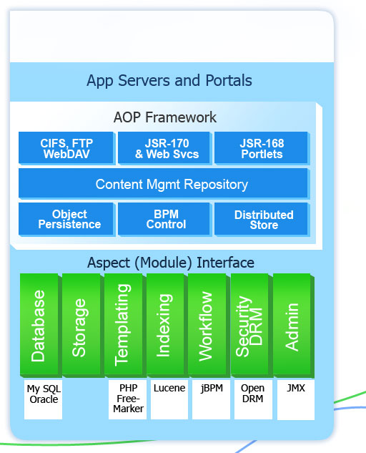
Architecture Scaffolding for Alfresco
Replace shared file drives with Virtual File System
Automatic Metadata Extraction
Simple Rules Automate Manual Processing
Portals Integration
Google-like search, Yahoo-like browsing
Folder-Based Workflow
SmartSpaces
  Folders, Content, Rules
Zero Footprint Client
New, Standards-based Architecture

Slide 42
ECM Vendor Assessment
Solution | Key Features | Pros | Cons
Documentum
Alfresco
SAP
Sharepoint
Requires Further Analysis

Slide 43
Configuration Mgmt Overview
Appendix E

Slide 44
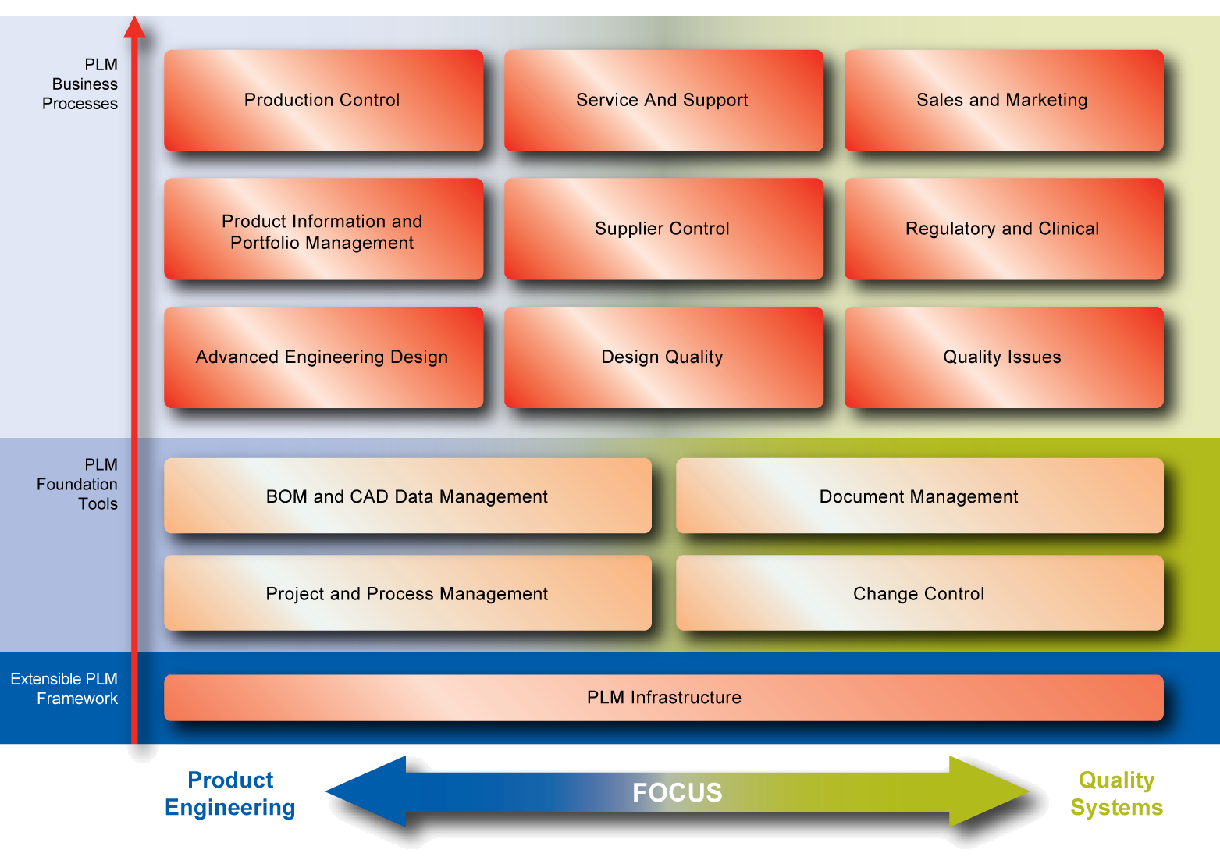
Enterprise Configuration Overview

Slide 45
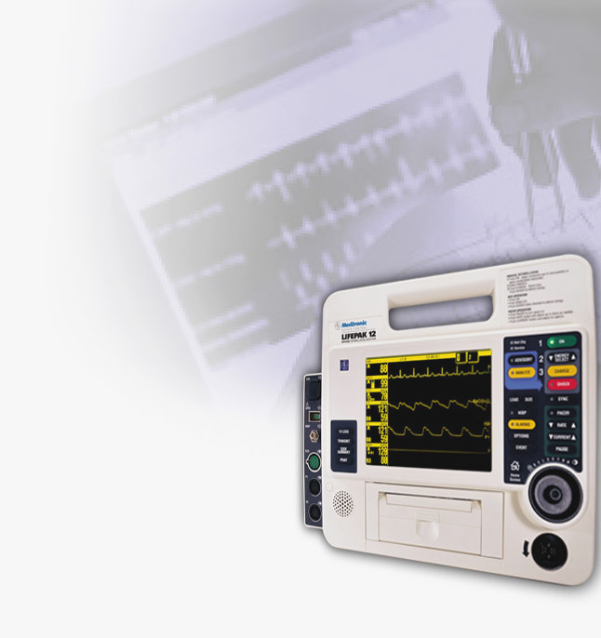
Medical Device Business Processes
NPI / PPM
CONCEPT &
FEASABILITY
DESIGN &
DEVELOPMENT
CLINICAL & REGULATORY
RAMP UP &
RELEASE
SERVICE &
SUSTAIN
Design History File
Product Design Innovation Product Portfolio Management
Project Portfolio Management
Project Planning/Scheduling
Project Execution
Project Deliverables
Project Phase Reviews
Project Resource Planning
Requirements & Validation
New Product Introduction / Product Portfolio Management
Requirement Management Validation
Traceability Matrices
Requirements & Validations
Product Design
Supplier Quality Mgt
Product Design
Manufacturing Design
Supplier Quality File
Part Quality Plan
Incoming Quality Inspection
Strategic Sourcing
Product Design Assessment
Design Authoring / xCAD
Design Structures / xBOM
Device Master Record
Design Visualization & Virtualization
Design Risk Management
Design Partner Collaboration
Packaging & Labeling
Supplier Quality Management
Clinical Trials
Regulatory Affairs
Regulatory Affairs
Quality Issue Management
Regulatory Document Collection
Submission Assembly
Publish Submissions
Electronic Submissions
Regulatory Relationship Mgt
Change Mgt
Production Control
Change Planning
Change Impact Analysis
Change Execution
Change Closure
Change Management
Document Mgt
Document Management
Quality Issue Mgt
Document Repository
Document Search
Document Collection
Document Lifecycle Mgt
Document Review / Expiration
Non Conformance Tracking
Investigate & Remediation
Quality Audits
Manufacturing Design
Production Control
Clinical Trials
Manufacturing Design Planning
Manufacturing Process Design
Manufacturing Equipment Design
Manufacturing Software Design
Industrial Engineering
Production System Integrations
Production Equipment Setup
Product State Control
Device History Record
Field Service
Clinical Trial Design
Clinical Trial Planning
Clinical Trial Deliverables
IDE Product Builds
Clinical Trial Provider Management
Clinical Trial Case Management

Slide 46
Configurator Vendor Assessment
Solution | Key Features | Pros | Cons
SAP
ConfigureOne
ILOG
MatrixOne
Requires Further Analysis

Slide 47
Integration Points
Appendix F

Slide 48
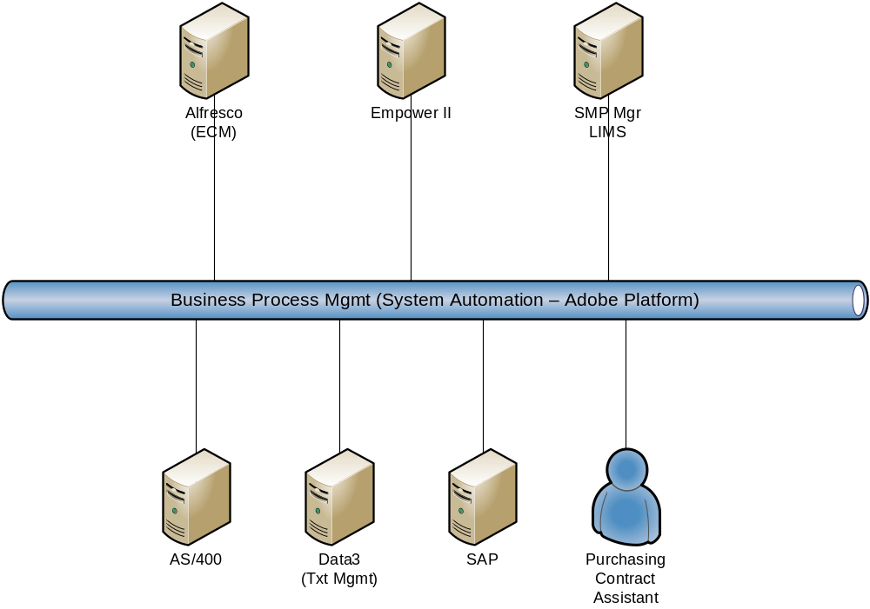
Supplier Processes and/or Systems

Slide 49
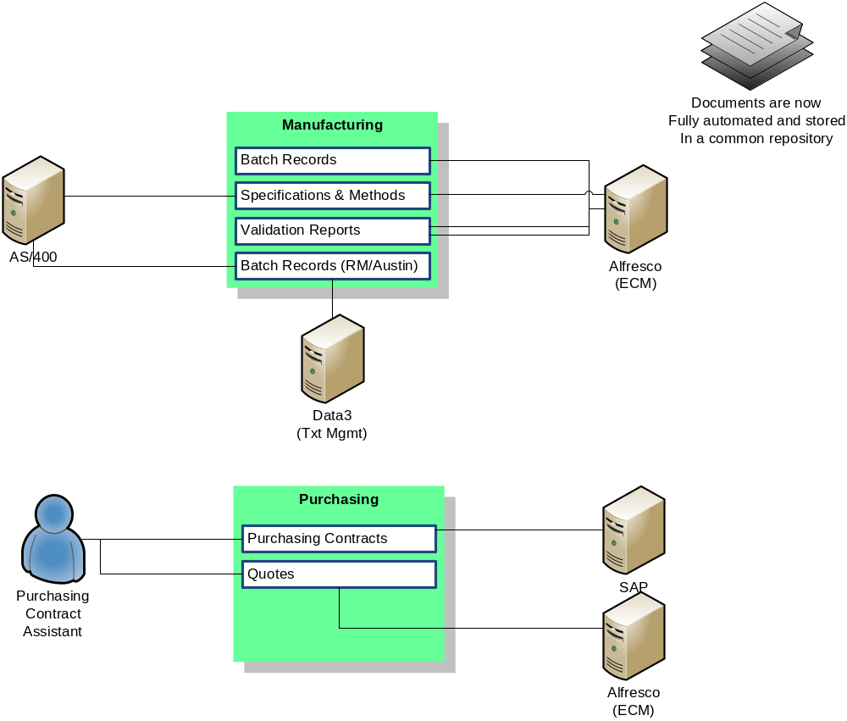
Manufacturing & Purchasing

Slide 50
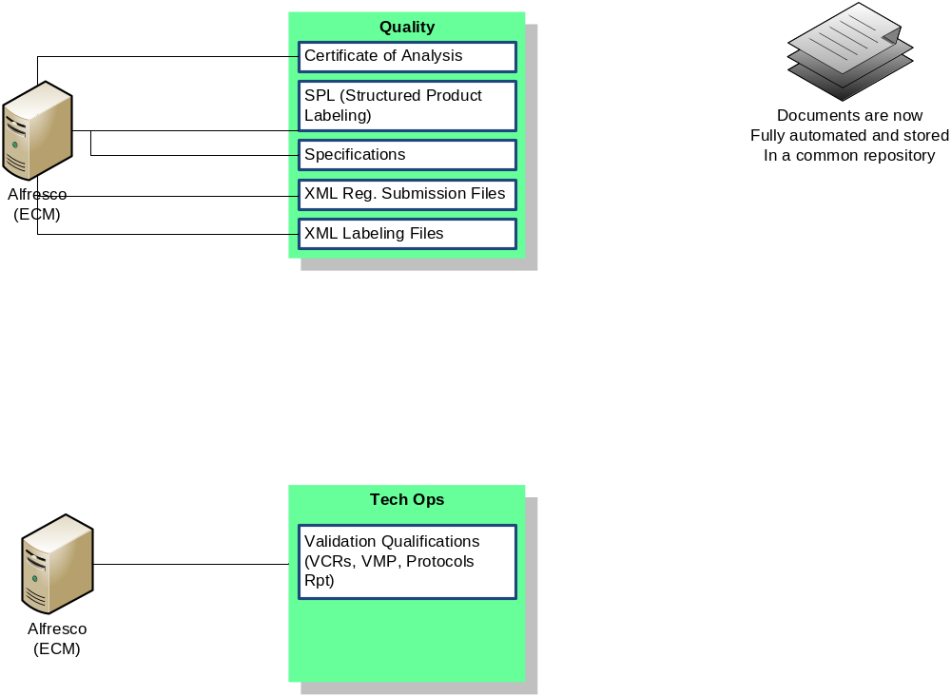
Quality & Technical Operations

Slide 51
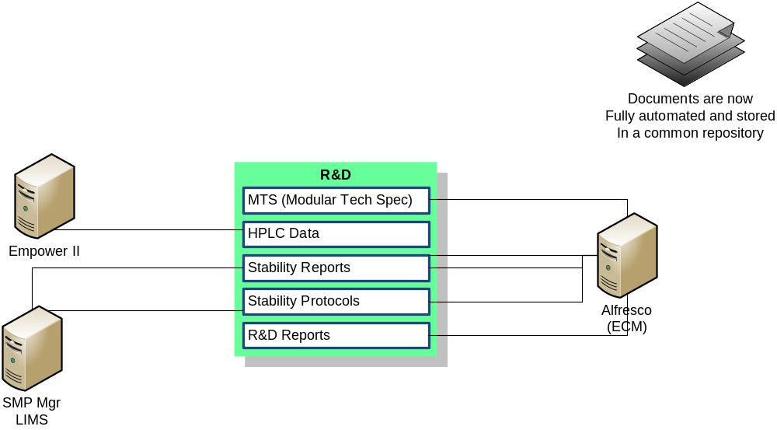
R&D

